Slide 1

Non blocking IO API
To provide a purely evented, non-blocking infrastructure to script highly concurrent programs....

Slide 2
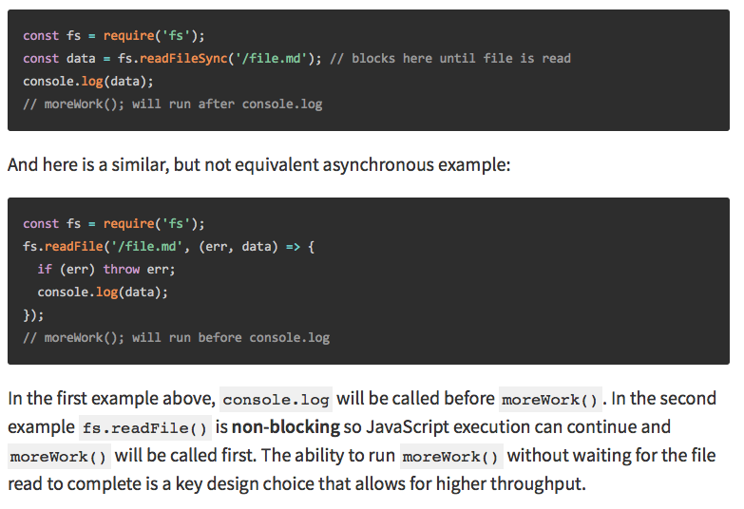
Evented non blocking (Ako to vyzerá)
https://nodejs.org/en/docs/guides/blocking-vs-non-blocking/
Spomeňte si na original design:
No function should directly perform IO
To receive info from disk, net or another process, there must be callback
A takto vyzerá “každé“ (IO) API v node.js, ale aj v browsri
Máte funkcie a tým dávate callbacky

Slide 3
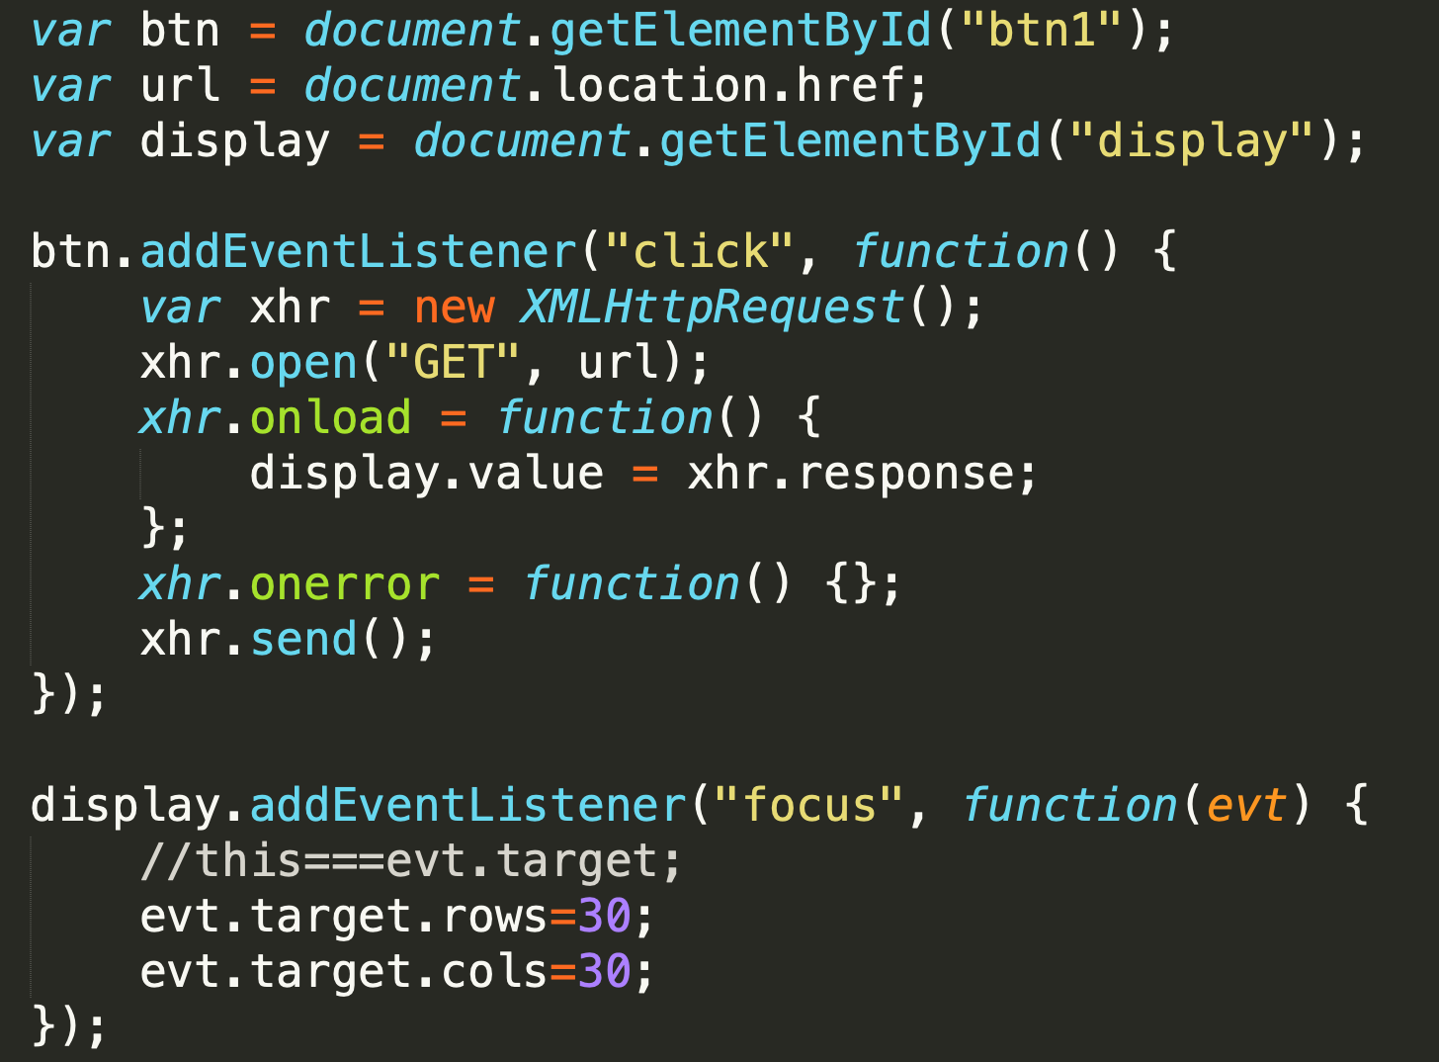
Evented non blocking (Ako to vyzerá)

Slide 4
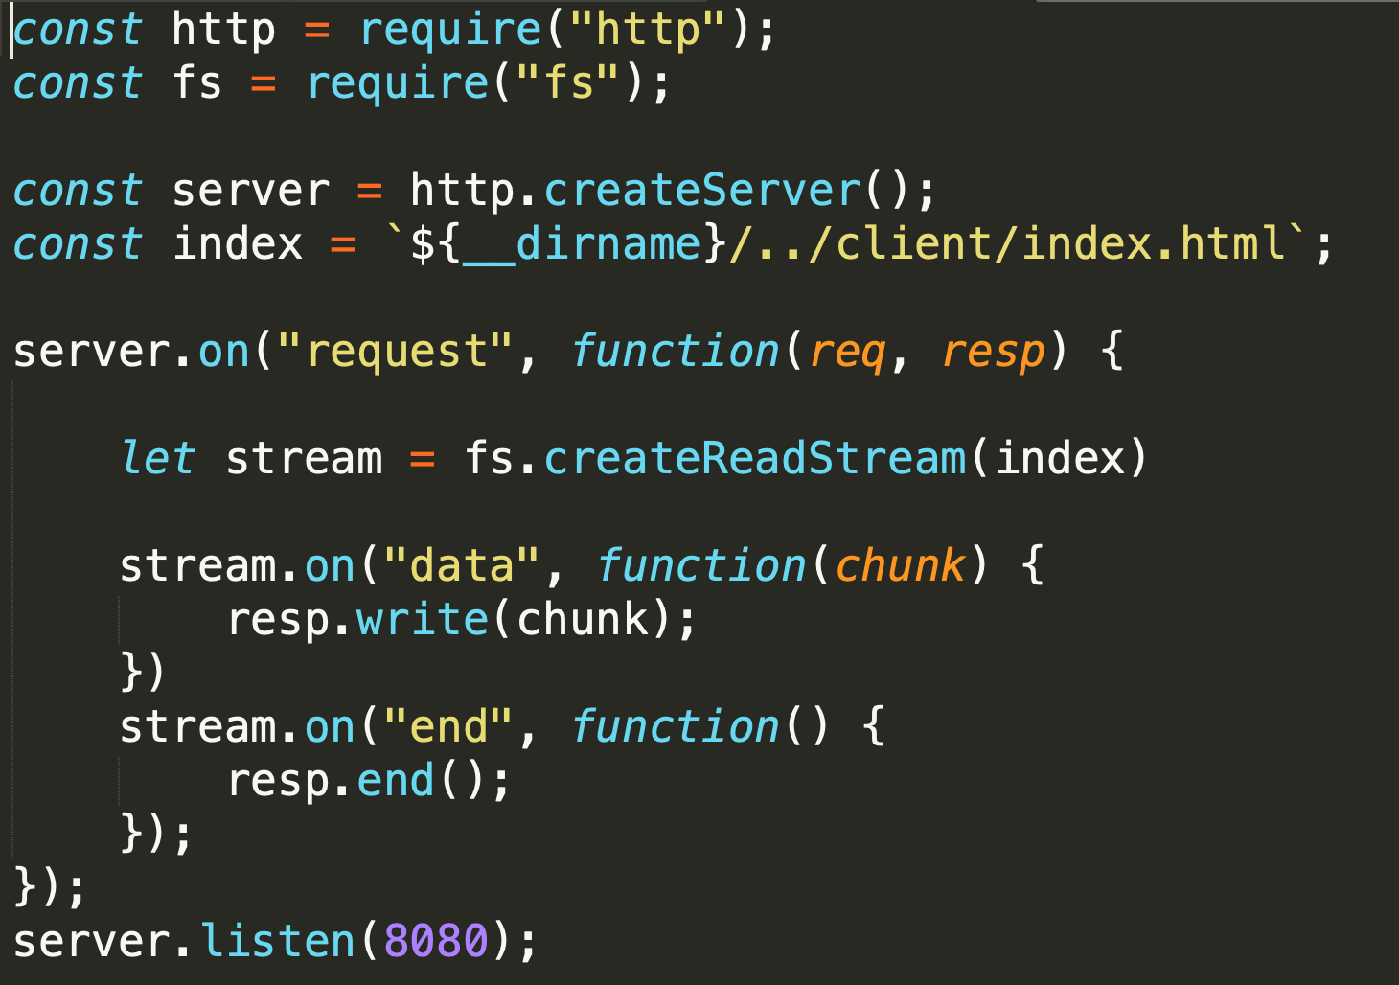
Evented non blocking (Ako to vyzerá)

Slide 5
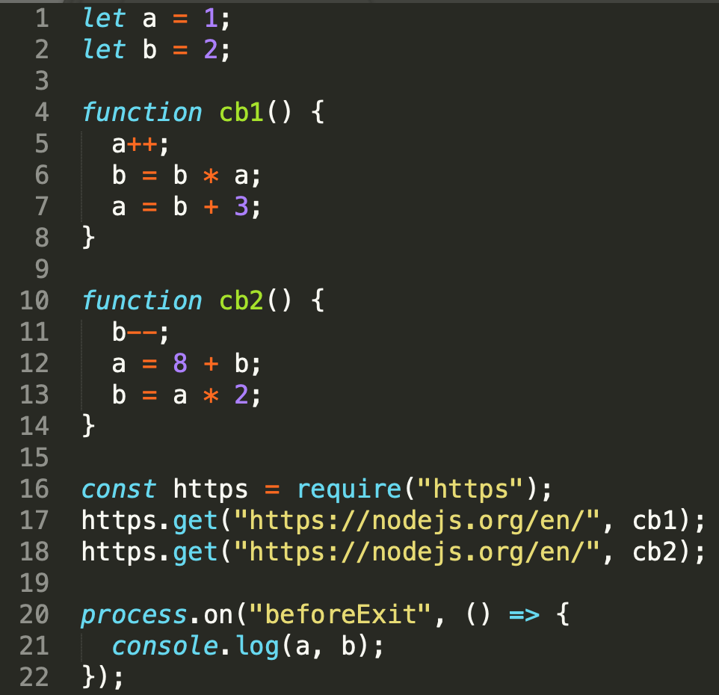
Evented non blocking (Ako to funguje)
1)
„compile“
4
10
global
cb1
cb2
V8 stack
1
2
16
17
18
20
5
6
7
11
12
13
21
node
2)
4
10
global
cb2
cb1
time
1
2
16
17
18
20
11
12
13
5
6
7
21
wait in queue
async: some code happends now [1,2,...] and some later [5,5,6], [11,12,13],[21]
concurrent: callbacks happen in certain timeframe but not in predictable and controllable order
run-to-completion: function is „atomic“ unit and must execute as whole, there is no chance for (11,5,12,... to happen)
$ node ./concurrency.js
11 22
$ node ./concurrency.js
11 22
$ node ./concurrency.js
183 180
$ node ./concurrency.js
11 22
/samples/concurrency.js
Notes:
Because cb1() can't be interrupted by cb2(), and cb2() can't be interrupted by cb1(),
this program only has two possible outcomes depending on which starts running first –
if threading were present, and the individual statements in cb1() and cb2() could be interleaved, the number of possible outcomes would be greatly increased

Slide 6
Event loop
How does it work
Single threaded and concurrent ?

Slide 7

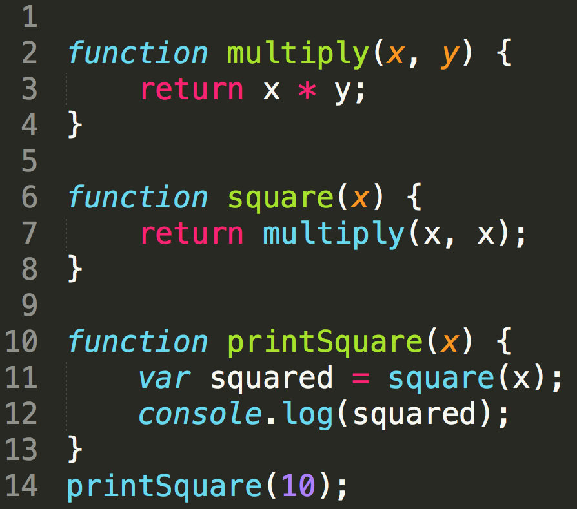
Stack
Your code
V8 – stack
lib-uv
multiply
square
console.log
Each function call is pushed on the stack
printSquare
main

Slide 8
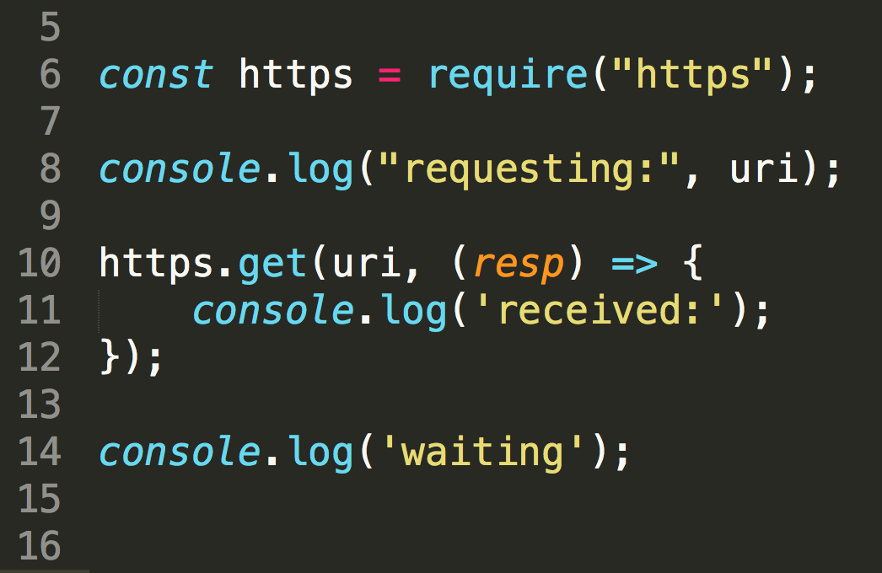

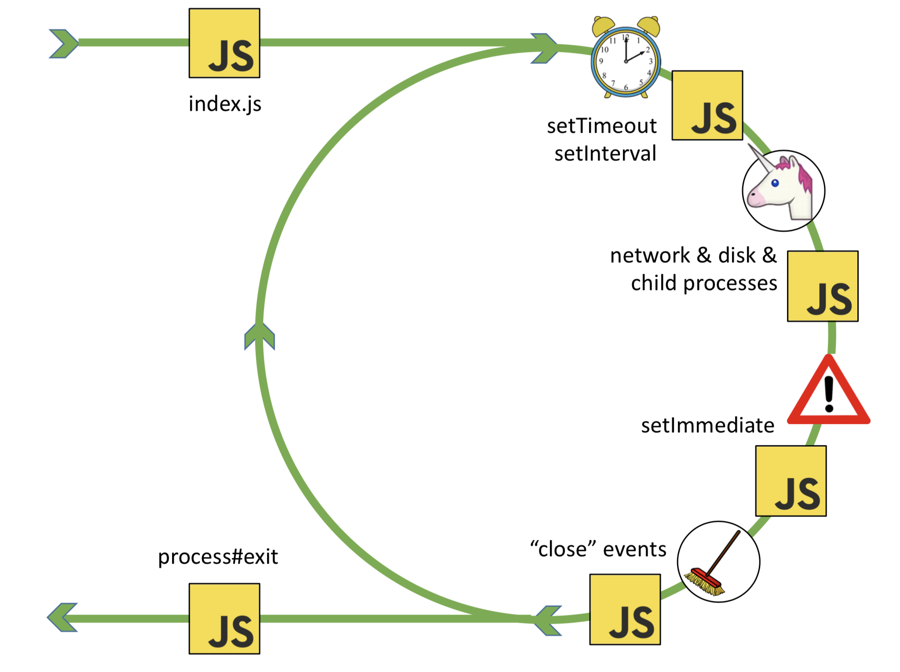
Event Loop
Your code
V8 – stack
lib
http.get(. )
(resp)=>{}
queue
Callbacks to async function get queued and are moved to stack for execution by event loop when stack is empty
(resp)=>{}
http.get
require
console.log
(resp)=>()
main

Slide 9
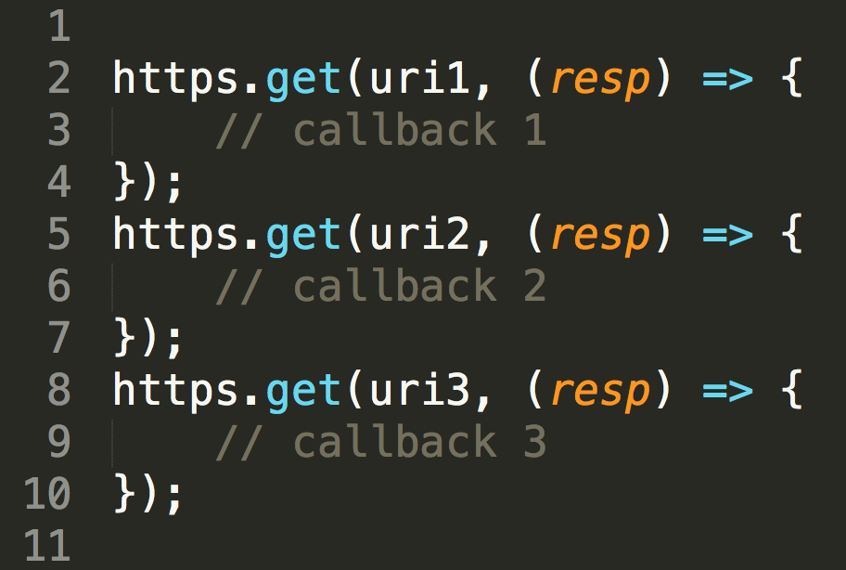
Event Loop - concurrency
Your code
V8 – stack
lib
http.get( )
cb1
http.get( )
cb2
http.get( )
cb3
queue
Many tasks can be launched in pararlell but only one callback can be on the stack at the same time
http.get(cb2)
http.get(cb1)
http.get(cb3)
cb3
cb1
cb2
cb3
main
cb2
cb1

Slide 10
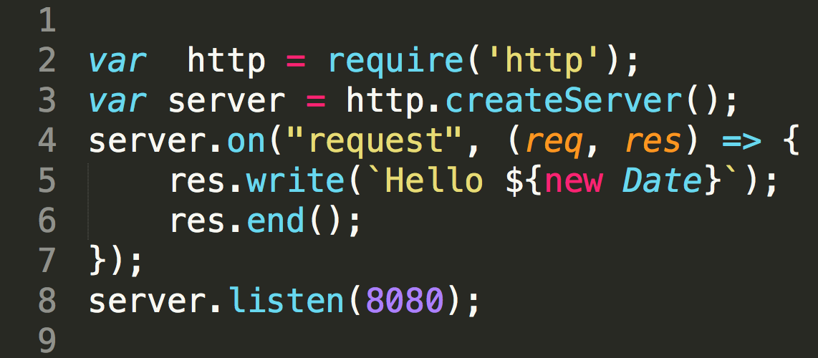
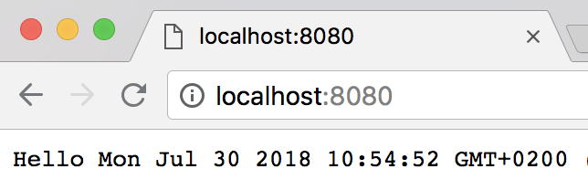
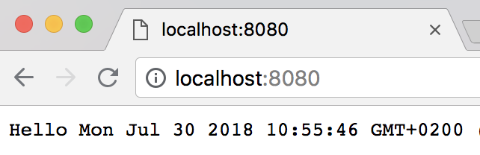
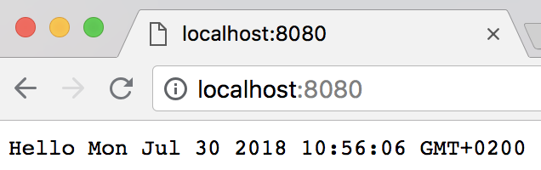
Event Loop – http server
Your code
V8 – stack
lib
listen( )
(req,res)=>{}
queue
(req1,res1)=>{}
(req2,res2)=>{}
(req3,res3)=>{}
listen
(req1,res1)=>{}
(req2,res2)=>{}
(req3,res3)=>{}

Slide 11
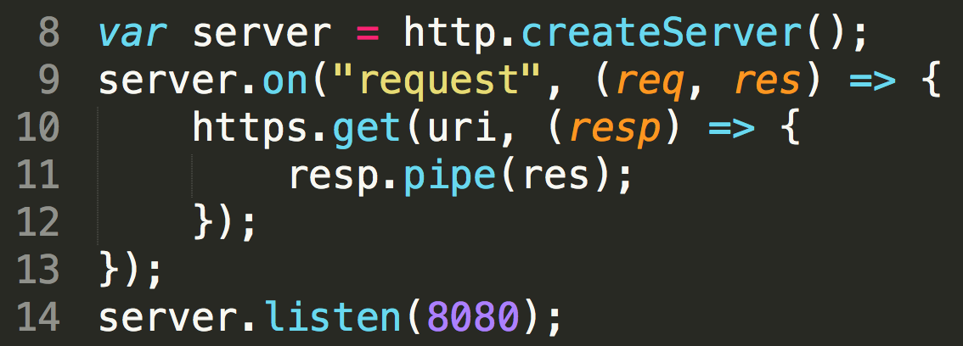
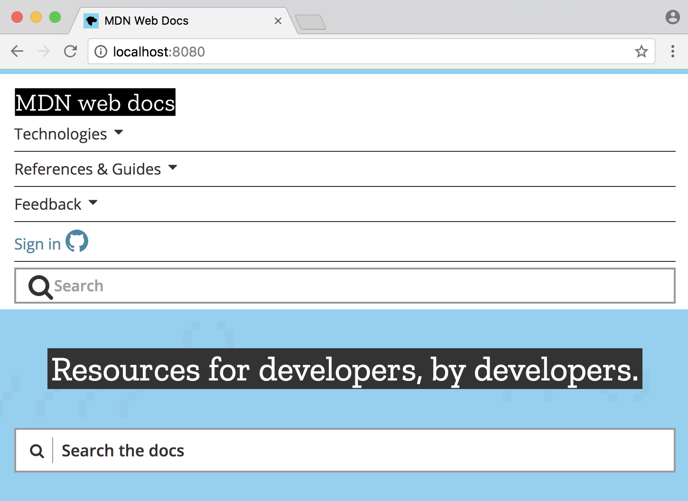
Event Loop – callback code
Your code
V8 – stack
lib
listen( )
(req,res)=>{}
https.get( )
(resp)=>{}
queue
resp.pipe()*
https.get()
Callback codes are usually async as well and create more async jobs resulting as queued items
(req1,res1)=>{}
listen()
(resp)=>{}
(req1,res1)=>{}
(resp)=>{}
* - just to simplify, resp.pipe is actually deeply async as well

Slide 12
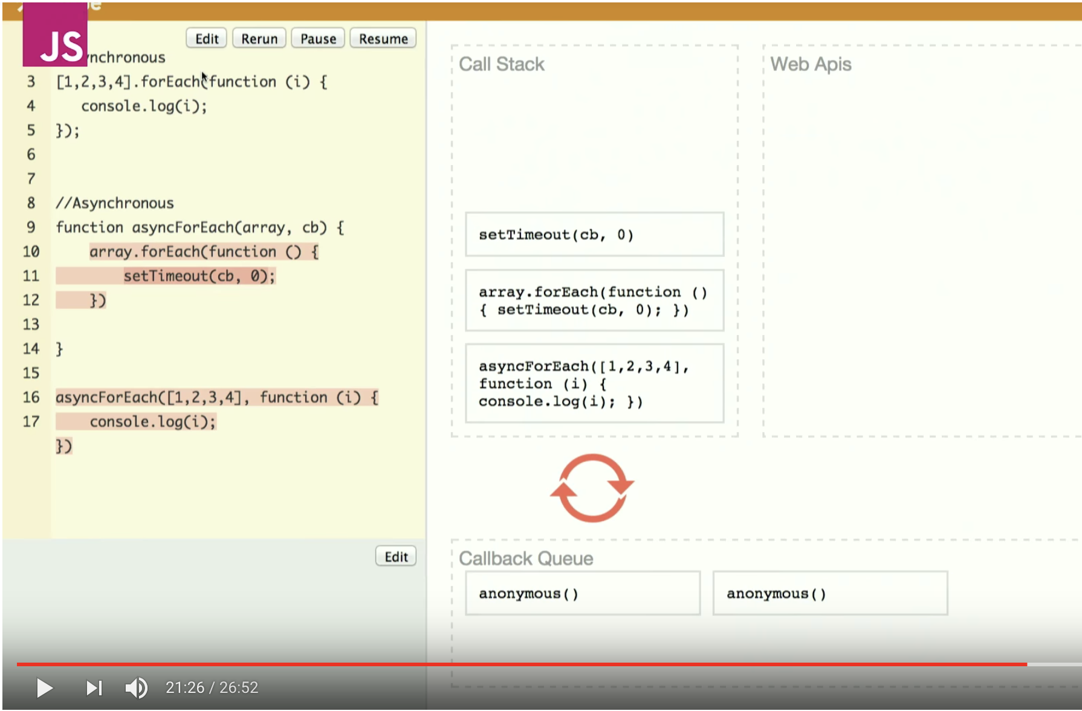
Event Loop and async forEach
https://www.youtube.com/watch?v=8aGhZQkoFbQ

Slide 13
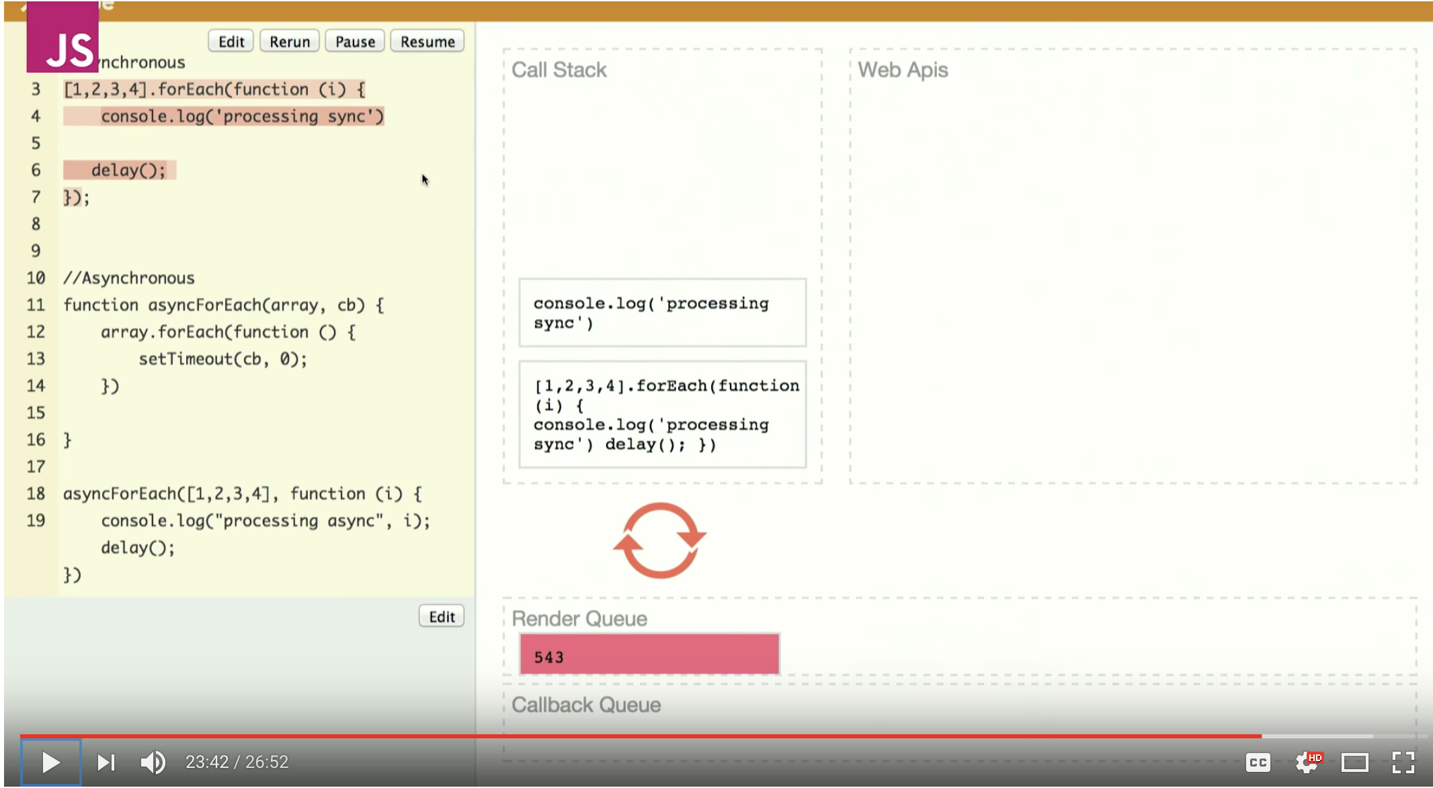
Event Loop and async forEach
sync version
Other tasks (render)
Are blocked for N*delay()
https://www.youtube.com/watch?v=8aGhZQkoFbQ

Slide 14
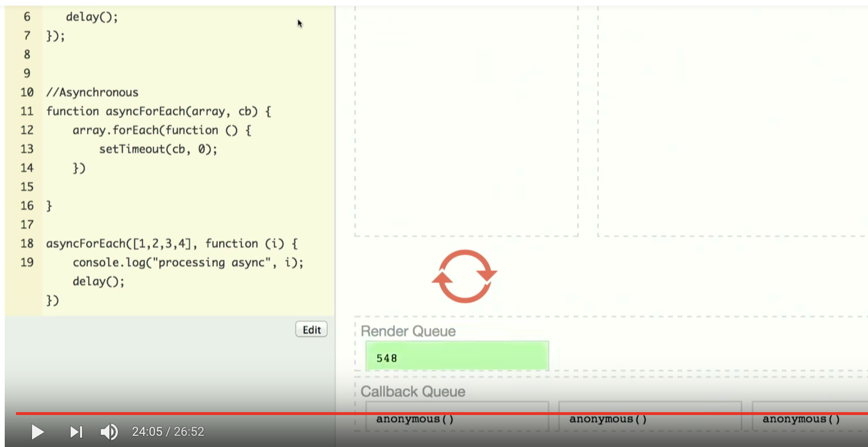
Event Loop and async forEach
async version
Other tasks (render) blocked only for N*queue()
Render has chance to execute between queued callbacks
https://www.youtube.com/watch?v=8aGhZQkoFbQ

Slide 15
Event Loop
lib
V8 – stack
api ( )
api ( )
Event Loop
api ( )
api ( )
queue

